Slide 1
Pseudocode
Ju An Park
MASc Candidate
Civil and Environmental Engineering
University of Waterloo, Canada
AE121: Computational Method
Last updated: 2019-07-21

Slide 2

Good job!
We have almost covered the fundamentals of MATLAB!
You deserve a good pat on the back ☺
So, you now know code can automate boring stuff or do really cool data stuff!
Before we dive into pseudocode, I’d like to show you some cool-ish stuff we can do with programming!
Notes:
2

Slide 3
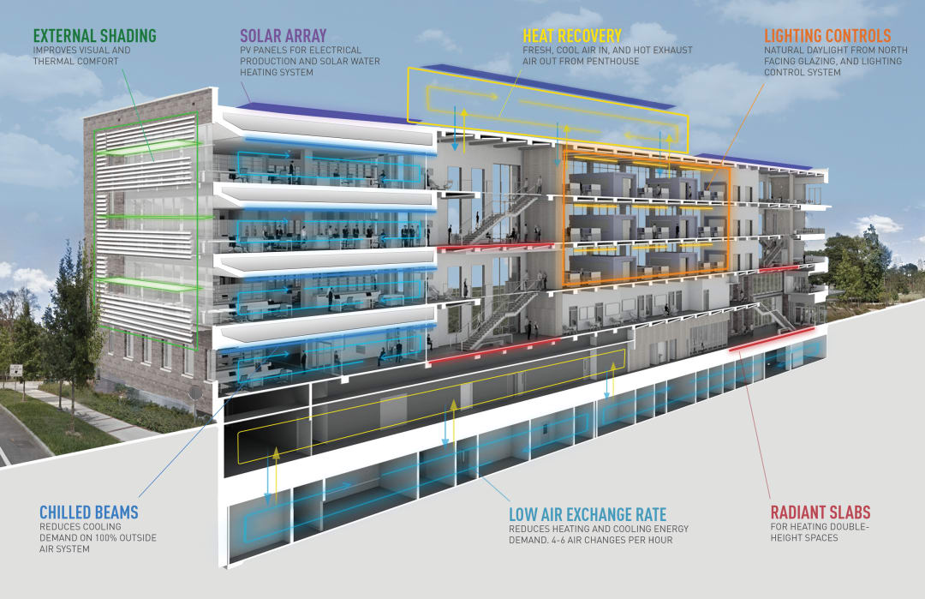
Coding Application Examples
Using code, you can:
Model different building properties
Heat exchange rates¹
Energy usage²/optimization
Generative Design³
Preliminary floor plan design⁴
Interior Design Assistant⁵
Notes:
3

Slide 4
Coding Application Examples
Using code, you can :
Model different building properties
Heat exchange rates¹
Energy usage²/optimization
Generative Design³
Preliminary floor plan design⁴
Interior Design Assistant⁵
Notes:
4

Slide 5
Coding Application Examples - 1: Hospital Heat Distribution Modelling (CFD)
Figure 1. Room layout
Figure 2. Temperature distribution and velocity vector in the room
Notes:
5

Slide 6
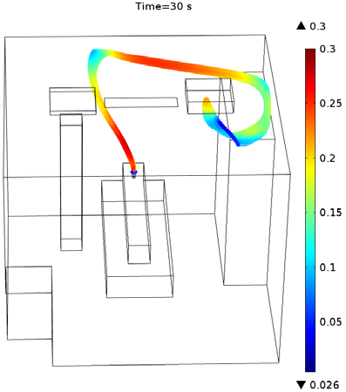
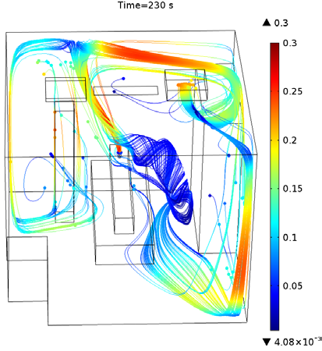
Coding Application Examples - 1: Hospital Air Particle Movement Modelling (CFD)
Figure 4. Particle tracing showing the motion of bacteria particles at 30 and 230 seconds after patient coughing.
Notes:
6

Slide 7
Coding Application Examples - 1: Applications?
Better understanding of different ventilation options leads to:
Increased energy efficiency
Reduce risk of airborne infection
Notes:
7

Slide 8
Coding Application Examples
Using code, you can :
Model different building properties
Heat exchange rates¹
Energy usage²/optimization
Generative Design³
Preliminary floor plan design⁴
Interior Design Assistant⁵
Notes:
8

Slide 9
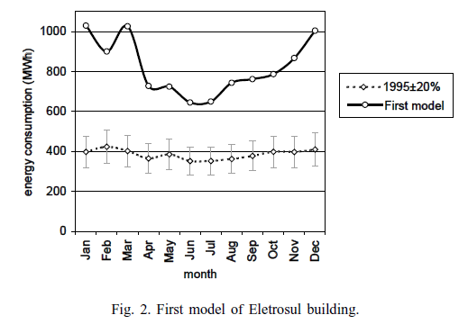
Coding Application Examples - 2: Building Energy Modelling
Fig. 1. Eletrosul building (10 000 m2).
Modelling Software: DOE-2, BLAST, ESP-r, ENERGY-PLUS
Notes:
9

Slide 10
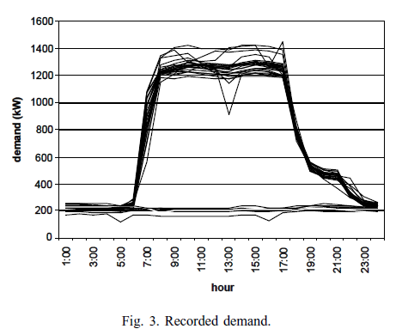
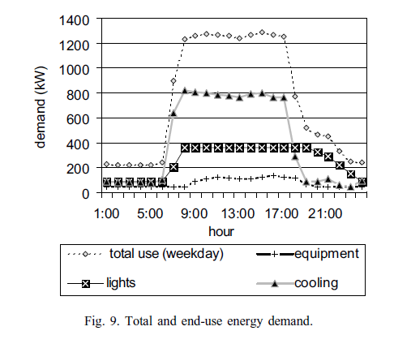
Coding Application Examples - 2: Building Energy Modelling
Notes:
10

Slide 11
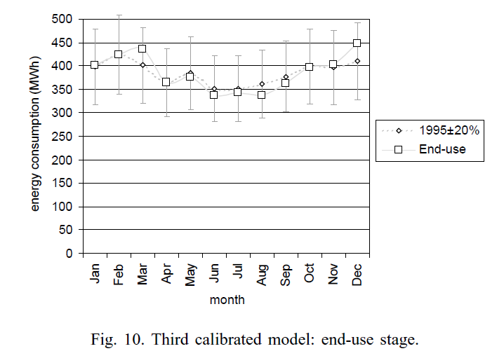
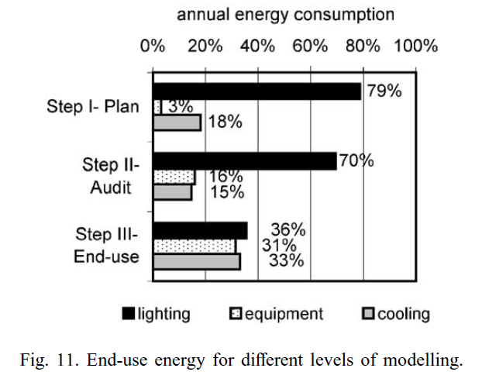
Coding Application Examples - 2: Building Energy Modelling
Notes:
11

Slide 12
Coding Application Examples - 2: Applications?
Better understanding of building energy usage
Better deal with peak energy demand situations
Determine CO2 emissions
Better compare different energy options (life cycle analysis)
Notes:
12

Slide 13
Coding Application Examples
Using code, you can :
Model different building properties
Heat exchange rates¹
Energy usage²/optimization
Generative Design³
Preliminary floor plan design⁴
Interior Design Assistant⁵
Notes:
13

Slide 14
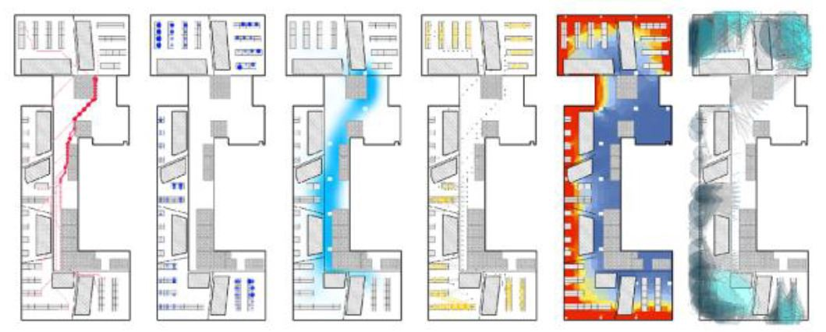
Coding Application Examples - 3: Generative Design
adjacency preference
work style preference
buzz
productivity
daylight
views to outside
Notes:
14

Slide 15
Coding Application Examples
Using code, you can :
Model different building properties
Heat exchange rates¹
Energy usage²/optimization
Generative Design³
Preliminary floor plan design⁴
Interior Design Assistant⁵
Notes:
15

Slide 16


Coding Application Examples - 4: Modern-to-Baroque Style Floor Plan Transfer
Notes:
16

Slide 17

Coding Application Examples - 4: Modern-to-Baroque Style Floor Plan Transfer
Notes:
17

Slide 18
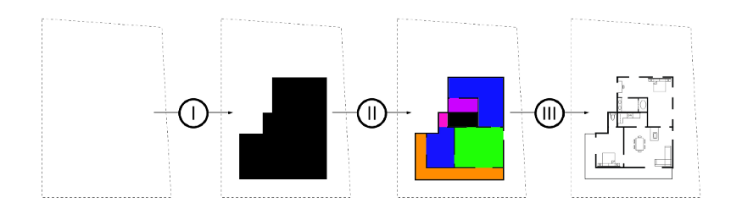
Coding Application Examples - 4: Automatic Layout Design
Parcel → Building Layout → Room Layout → Furniture Layout
Notes:
18

Slide 19

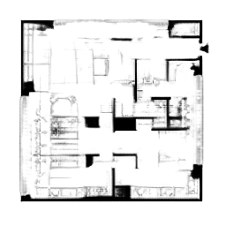
Coding Application Examples - 4: Automatic Layout Design Inception
Room Layout Generation
Detailed Layout Generation
Notes:
19

Slide 20
Coding Application Examples
Using code, you can :
Model different building properties
Heat exchange rates¹
Energy usage²/optimization
Generative Design³
Preliminary floor plan design⁴
Interior Design Assistant^{5, 6}
Notes:
20

Slide 21
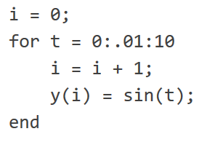
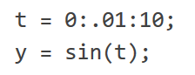
Introduction
We want code to be easy to read, organized, concise, and efficient
Example: Compute sine of 1,000 values ranging from 0 to 10:
Option 1 (For-loop) Option 2 (Vectorized)
We will learn techniques/guidelines to write clean, easy to understand code!
Notes:
21

Slide 22
Pseudocode - Overview
Our learning outcomes for this lecture is:
Pseudocode
Flowcharts
How to debug code!
If time permits, we can cover the following:
Coding Guidelines
Commenting Guidelines
Extra-resources:
Googling Guidelines
(Cause googling, is a skill.)
Notes:
The links are reading material students can read on their own time if they’d like.
22

Slide 23
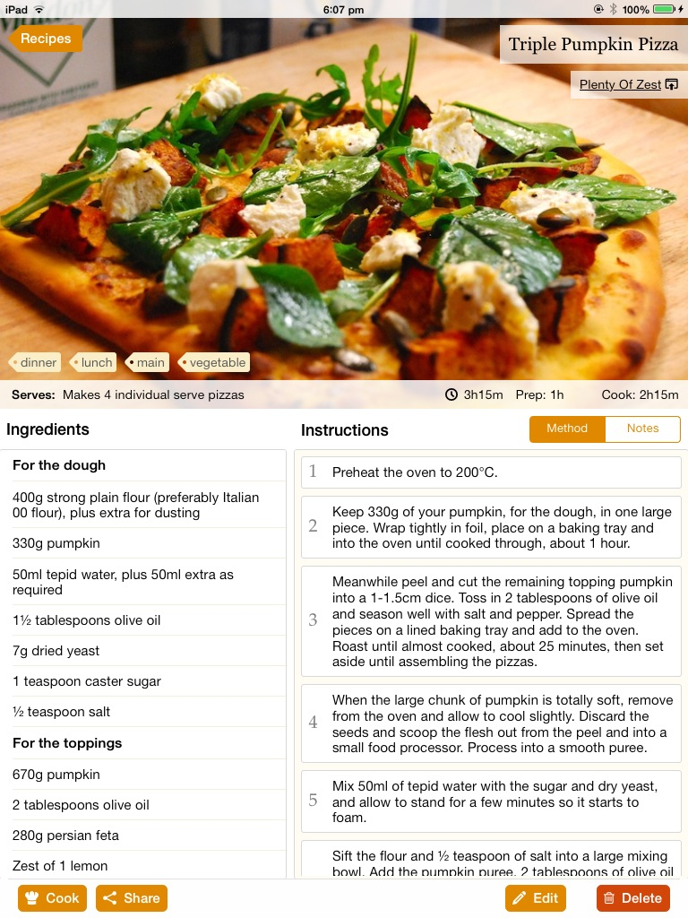
Pseudocode - Analogy
An analogy to pseudocode is a cooking recipe (lol)
To cook a dish, you need to know what materials to use, and how to cook it.
Huzzah!
Notes:
23

Slide 24
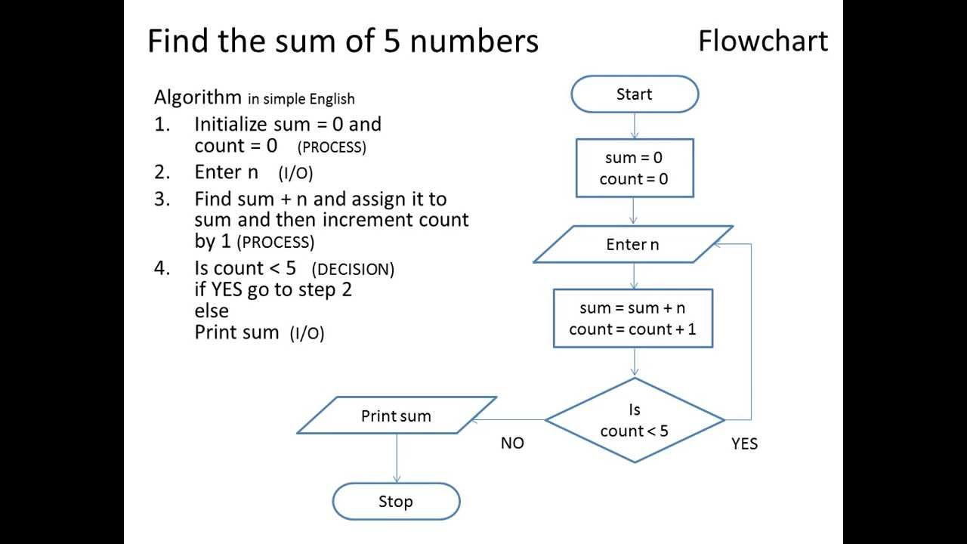
Pseudocode - Introduction
What is pseudocode?
A general, step-by-step description of your code that you can transcribe into actual code.
Pseudocode:
Initialize sum and count variables
While count < 5
Store user input number
Add user input number to total sum
Add 1 to count
Print total sum
Notes:
24

Slide 25
Pseudocode - Steps
Pseudocode summarizes a program’s flow but excludes the details
We need to know:
general step-by-step instructions
input/process/output variables
General Thought Process (IDEAS):
Identify the problem
Define the input and output variables
Establish solution steps
Analyze solution
Solve
Notes:
25

Slide 26
Pseudocode – 2_example_1.m
Calculate the sum & average for array containing ‘n’ numbers:
Identify the problem
Calculate sum and average for an array of variable size
Define the input and output variables
Input: numbers (n-sized array)
Output: summed, averaged
Establish solution steps
Count how many elements there are in an array
Loop through array to sum up numbers to get sum
Divide sum by total number of arrays to get average
Return the variables
Analyze solution
Need sum variable (accumulator), need numel function (array_length), need “for”, to loop through array
Solve (write the code)
Notes:
26

Slide 27
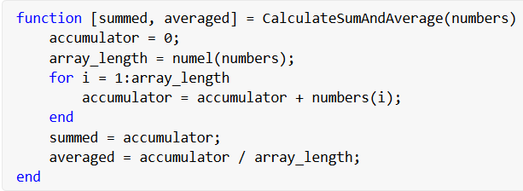
Pseudocode – 2_example_1.m
Calculate the sum & average for array containing ‘n’ numbers:
Pseudocode
Given: n-sized numerical array
Output: Calculate sum and average
Steps:
Initialize accumulator to 0
Count elements in array
Loop through array
- Accumulate numbers
Calculate average
Return sum and average
Notes:
27

Slide 28
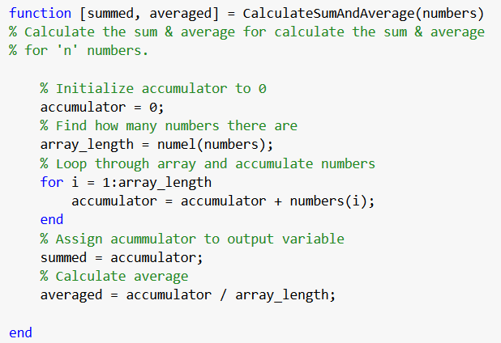
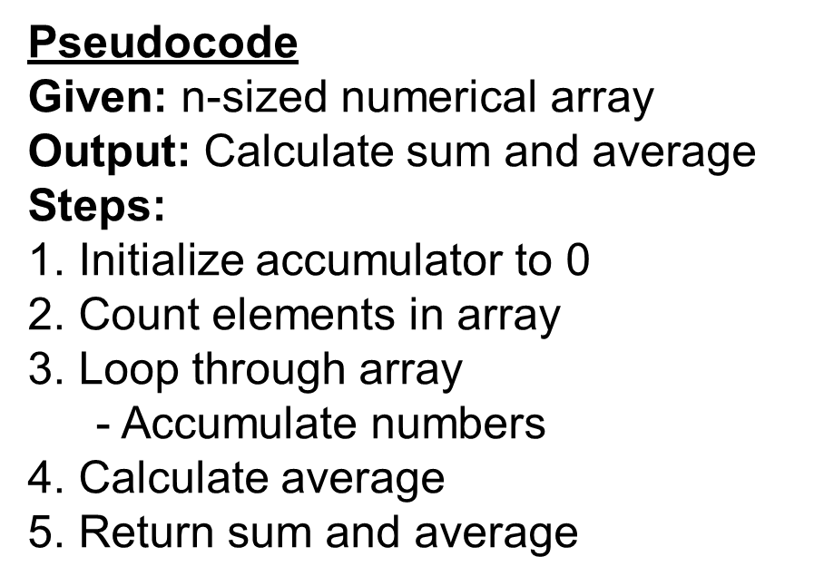
Pseudocode – 2_example_1.m
Benefits of pseudocode:
You can debug code faster (resolving logical and syntax errors)
Everyone can understand code faster to use/help
Pseudocode can be used as comments to explain the code functionality:
Pseudocode put into script as comments to give readers a human-level description
Notes:
Again, a refresher on what logical vs syntax errors are.
28

Slide 29
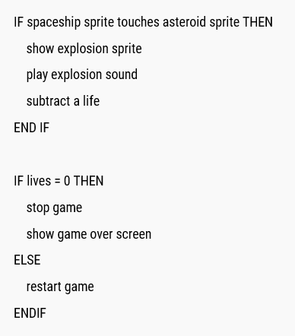
Pseudocode – Some guidelines
Some guidelines to writing good pseudocode:
Use control structures
Loops (for and while), if/elif/else statements, functions, or switch statements
Notes:
29

Slide 30
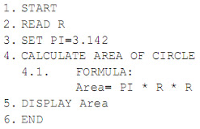
Pseudocode – Some guidelines
Some guidelines to writing good pseudocode:
Clear naming convention
num_rows vs a? Which variable gives more information?
Or how about a, b, c vs R, PI, Area?
Notes:
30

Slide 31
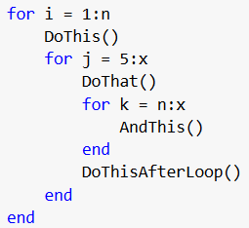
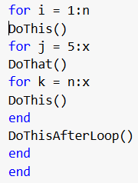
Pseudocode – Some guidelines
Some guidelines to writing good pseudocode:
Indenting when using control structures – it makes a big difference!
vs
Which one is more easy to understand?
Notes:
31

Slide 32
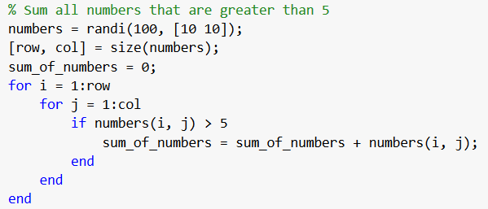
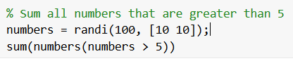
Pseudocode
Simplicity when writing pseudocode/code
Maximize code efficiency by using vector operations or logical masks instead of for loops, and using minimal number of control structures)
vs
11 lines vs 3 lines of code!!
Notes:
32

Slide 33
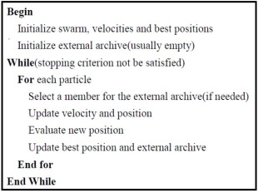
Pseudocode – more examples
There is no end-all standard to pseudocode!
Pseudocode should be as concise, easy to understand, and clear, as possible.
Notes:
Again, a refresher on what logical vs syntax errors are.
33

Slide 34
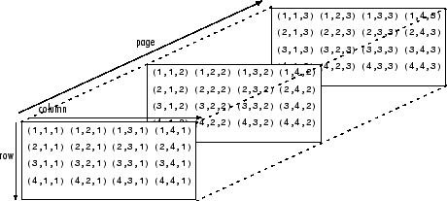
Pseudocode – 2_example_2.m
Given an N-dimensional array, find the maximum value.
So given an array that could be length, n, or n x m, or n x m x o, and so on, how can we find the max without using the function max?
Example: a 5-dimensional array
Notes:
34

Slide 35
Pseudocode – 2_example_2.m
Given an N-dimensional array, find the maximum value
Identify the problem
Find the maximum value given a. n-dimensional array
Define the input and output variables
Input: numbers (n-dimensional array)
Output: max_number (scalar variable)
Establish solution steps
Initialize max_number and set first element in numbers as the max variable
For-loop through rest of the array using linear indexing
If max_number < number
max_number = number;
Analyze solution
Solve
Notes:
35

Slide 36
Pseudocode – Simple Example Solution
Given an N-dimensional array, find the maximum value.
Example Pseudocode (more code-like):
Function: Find Max of a N-dimensional array
Input: numbers (the n-dimensional array)
Output: max_number (the maximum number)
Pseudocode:
max_number = numbers(1)
for i = 2:numel(numbers)
if max_number < numbers(i)
max_number = numbers(i)
Return max_number
Notes:
36

Slide 37
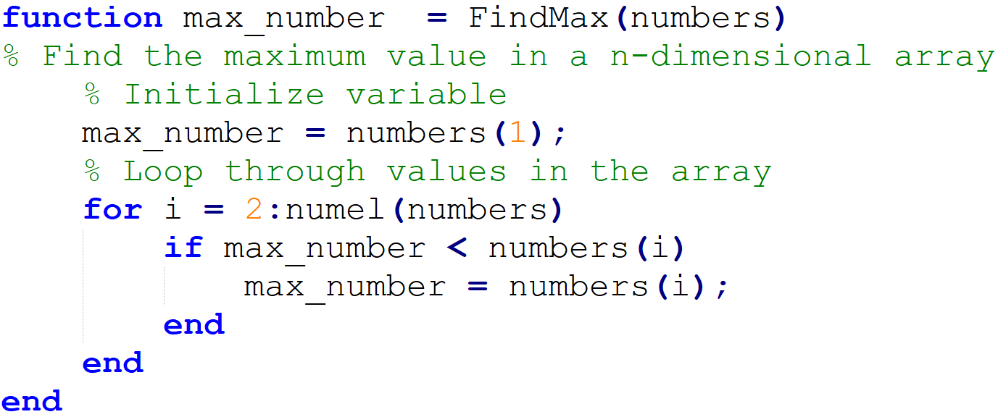
Pseudocode – Simple Example Solution
Given an N-dimensional array, find the maximum value.
Code:
Indents!
Less-ambiguous variable names
Notes:
37

Slide 38
Pseudocode – Quiz
Given a 2-D array, create a function that sorts each row or column of the array in ascending order and gives its sorted linear indices.
Sample array: Output (sorted array, linear index):
Linear Index!
Sorted Array:
1⁴ | 2⁷ | 3¹
1⁸ | 5² | 6⁵
1³ | 4⁹ | 8⁶
3¹ | 1⁴ | 2⁷
5² | 6⁵ | 1⁸
1³ | 8⁶ | 4⁹
Sorted Array’s Linear Index:
Feel free to share your pseudocode with your classmates here
Notes:
38

Slide 39
Pseudocode – Quiz Answer
Example Pseudocode:
Function: Sort each row or column of the array
Input: array_2D, sort_option (‘r’ for rows, ‘c’ for columns)
Output: sorted_2D_array and linear_indicies
Pseudocode:
Initialize an array of zeros of shape array_2D and assign to variable ‘linear_indices’
Initialize an array of zeros of shape array_2D and assign to variable ‘sorted_2D_array’
If sort_option is ‘r’
Loop through each row
Initialize row vector called “row” that contains its row values
Initialize row vector called “row_indices” that contains its linear indices
Sort row and update row_indices (Any sorting algorithm can be chosen)
Assign the sorted row and row_indices to the corresponding row in sorted_2D_array and linear_indices, respectively
If sort_option is ‘c’
Loop through each column
Repeat steps like sort_option “r” but for columns
Keep in mind there are many right answers!
Your solutions may differ.
Notes:
The key here is o
39

Slide 40
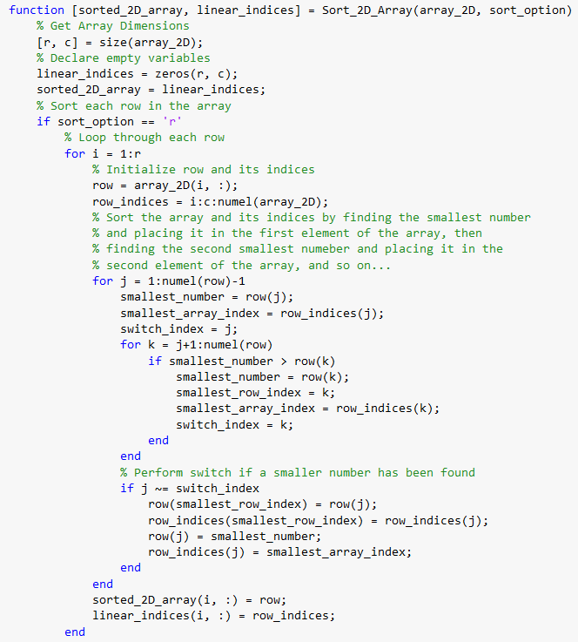
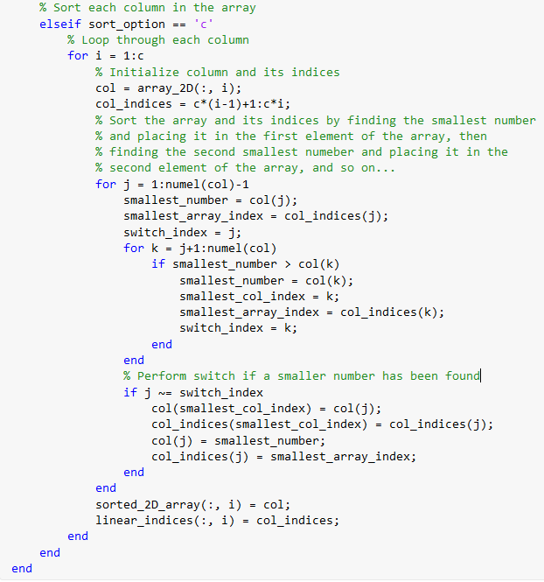
Pseudocode – Quiz Answer (3_quiz_answer.m)
Given a 2-D array, create a function that sorts each row or column of the array in ascending order and gives its sorted linear indices.
Code:
Notes:
40

Slide 41
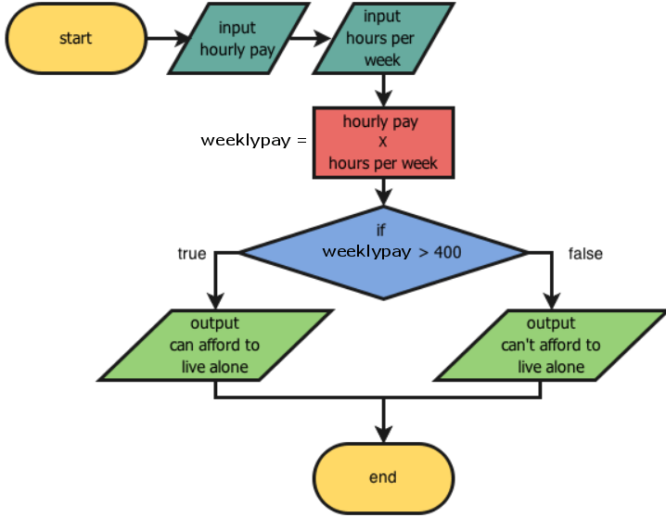




(Optional) Flowcharts
An alternative to pseudocode is a flowchart!
A flowchart is a visual representation of pseudocode.
This example calculates weekly pay and determines if one can live alone:
Flowcharts are good to visualize and understand code flow, but cannot be used as comments in code.
A good flowchart maker is LucidChart.
Note: The shapes and colors of the blocks indicate if it is the:
start/end of code
a computation
input/output
a conditional/loop structure
Connection from one part
of the code to the next
Notes:
There are some programmers that use pseudocode as comments to explain code. But since flowcharts are visuals, it is impossible to do. It is a separate file.
41

Slide 42
Pseudocode vs Flowchart Comparison
Flowchart:
Pseudocode:
Initialize sum and count variables
While count < 5
Store user input number
Add user input number to total sum
Add 1 to count
Print total sum
VS
Notes:
42

Slide 43
Debugging Tutorial
In this section, we will learn how to:
Debug logical errors
Debug syntax errors (most frequent)!
Refer to this.
Notes:
43

Slide 44
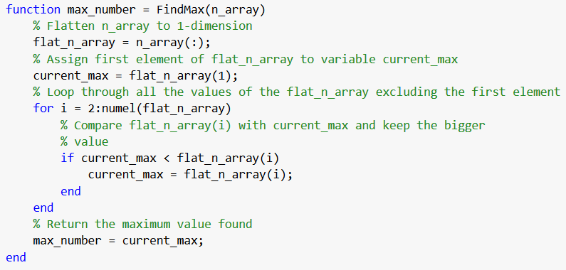
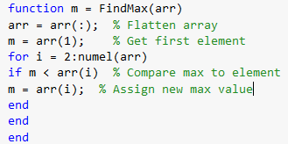
Clean Coding Guidelines
Clean, clear, and readable code is really important!!
“Imagine you have written a script that finds the max of an n-dimensional array, and you must modify the code to find the 2nd highest number instead.”
Which version of code is easier to understand?
Let’s learn to write clean code!
VS
Notes:
44

Slide 45
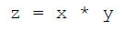
Clean Coding Guidelines – Naming Conventions
The purpose of naming conventions are to help the reader and programmer.
Variable names should describe in short what they are/do:
VS
a. Write variable names in mixed case starting with lower case
Ie. nNames, town, or isCaseOpen
b. Write variable names in lower case separated by underscore
Ie. n_names, town, or is_case_open
Use a prefix (typically “n” or “m”) for variables representing number of objects
Ie. “nFiles”, or “nPoints”, etc…
Notes:
45

Slide 46
Clean Coding Guidelines – Naming Conventions
Minimize abbreviation in names
Ie. “compareArrivalTime” vs “cmpAT”
Use action verb/state prefixes to describe a variable. For example:
“has/is/can/should” for Boolean variables (“isComplete”, “canRun”)
“find/get/compute” for functions (“findMax”, “getArray”, “computeMatrix”)
Use suffixes for dimensioned variables and constants
Ie. “angleRadians”, “lengthCM”, “weightNewtons”
Notes:
46

Slide 47
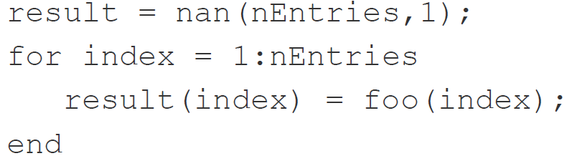
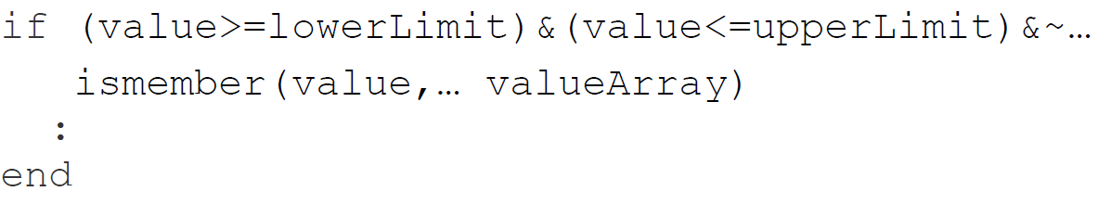
Clean Coding Guidelines – Statements
Minimize use of repurposing variables to avoid confusion
Initialize loop result variables immediately before the loop (more efficient!)
Avoid complex conditionals – use temporary logical variables instead:
Instead of this:
Notes:
47

Slide 48
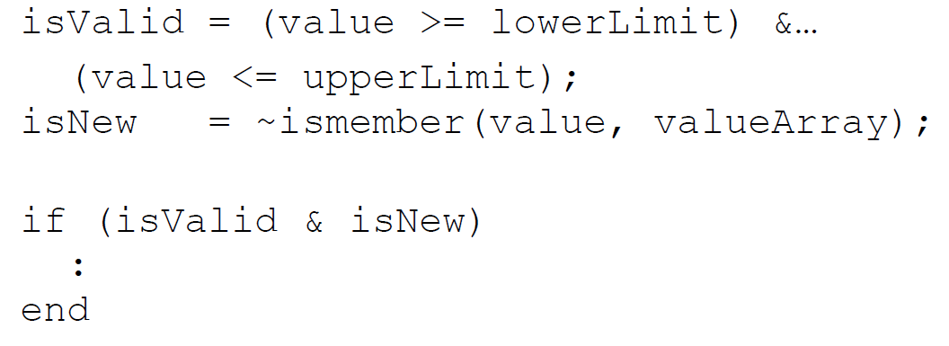
Clean Coding Guidelines – Statements
Do this:
Notes:
48

Slide 49
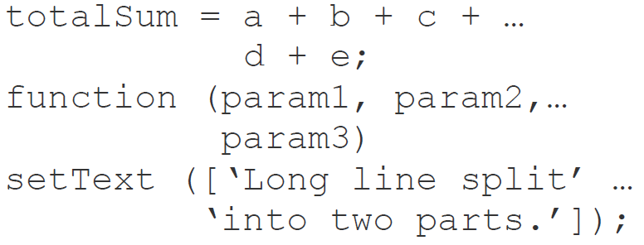
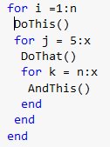
Clean Coding Guidelines - Format
Keep lines of code within 80 columns
Split lines at commas/operators using the continuation (…) operator
Indent 3 or 4 spaces (or 1 tab) for an indented block of code
VS
Notes:
49

Slide 50
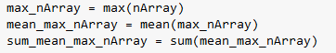
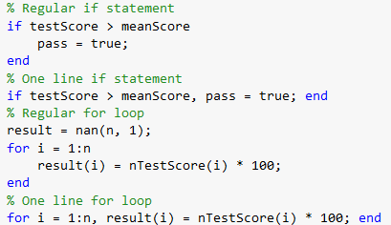
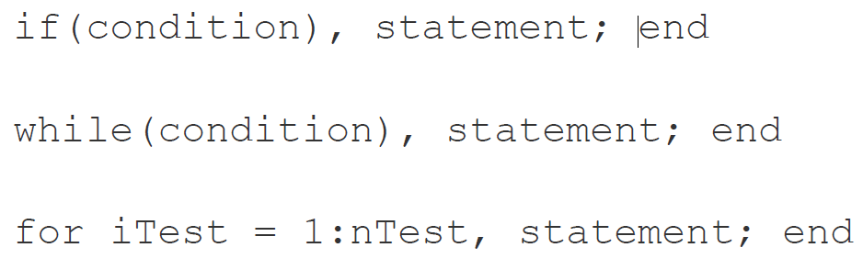
Clean Coding Guidelines - Format
Write one executable statement per line of code
This: is more readable than this:
Single statements using if/for/while statements can be written on one line of code
Notes:
50

Slide 51
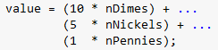
Clean Coding Guidelines - Format
Add white space between operators, commas followed by space
Ie. a+b+c+d vs a + b + c + d or a,b,c,d vs a, b, c, d
Use alignment wherever it enhances readability
VS
Notes:
51

Slide 52
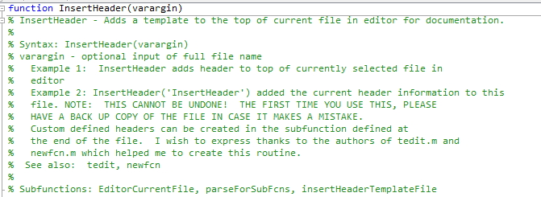
Commenting (Pseudocode) Guidelines
Header comments (for the user)
At the top of the script, programmers usually place a block of code containing the purpose of the script, input/outputs, and methods of use.
Note: Write the function name in comments using its actual case.
Notes:
52

Slide 53
Commenting (Pseudocode) Guidelines
Use in-line comments to explain blocks of code
Comments cannot justify poorly written code!
Indent code comments the same as the statements referred to.
Minimize use of end of line (EOL) comments.
For more detailed explanations, refer to this document!
Notes:
53

Slide 54
Feedback
Any feedback is greatly appreciated!
https://forms.gle/U8cBwQaWVkMuvtfi9
Notes:
54

Slide 55
Slide Credits and References
https://economictimes.indiatimes.com/definition/pseudocode
https://www.unf.edu/~broggio/cop2221/2221pseu.htm
https://sites.google.com/a/ismanila.org/oliverab_cp/python/pseudocode
https://en.wikipedia.org/wiki/Pseudocode
https://www.geeksforgeeks.org/how-to-write-a-pseudo-code/
https://davidzych.com/writing-code-using-the-pseudocode-programming-process/
https://en.wikipedia.org/wiki/Comment_(computer_programming)#Planning_and_reviewing
https://softwareengineering.stackexchange.com/questions/67852/do-you-also-forget-the-code-after-getting-the-task-done
https://www.computerhope.com/jargon/s/script.htm

Slide 56
Image Credits
https://www.clareecho.ie/wp-content/uploads/2017/10/good-job-meme.jpg
https://www.youtube.com/watch?v=vOEN65nm4YU
http://plentyofzest.com/static/images/zest-webshot-recipe.jpg
http://computersciencementor.com/wp-content/uploads/2017/02/pseudocode.jpg
https://www.computerscience.gcse.guru/wp-content/uploads/2018/03/pseudocode-example.png
http://4.bp.blogspot.com/_FTeNn51Pac0/TLapqY7DAsI/AAAAAAAAABc/1aYEqOputDA/s320/pseudocode.bmp
https://www.researchgate.net/figure/Structure-of-MOPSO-a-simple-pseudo-code_fig6_273479296
https://www.mathworks.com/help/examples/matlab/win64/nddemo_02.gif
https://www.mathworks.com/matlabcentral/mlc-downloads/downloads/submissions/12323/versions/3/screenshot.jpg
http://beyondefficiency.us/blog/aia-code-ethics-finally-incorporates-sustainability-rule
https://interestingengineering.com/5-ways-artificial-intelligence-is-changing-architecture
https://www.comsol.com/paper/download/257311/kermani_paper.pdf
https://www.sciencedirect.com/science/article/pii/S0360132302000513
https://www.designingbuildings.co.uk/w/images/9/9b/Corridor.jpg
https://commons.wikimedia.org/wiki/File:St-Anne_church_Krakow_003.JPG

